Slide 1
Opinion Mining on Twitter Data using Machine Learning
Project batch No:- 07
Under the guidance of :-
M. Kishore Babu
Assistant Professor
Team Members:-
19BQ1A05I9 - R.Vinay
19BQ1A05I2 - P.Manjunath
19BQ1A05H6 - P.Srinivas
19BQ1A05D2 - M.Niharika

Slide 2
Introduction
Opinion mining, also refers as sentiment analysis, where we want to determine the sentiment of the document.
The main objective of Opinion mining on Twitter data is to find a way to discover what people like, what they prefer, or how they feel about a particular topic or product.
This analysis is implemented on both Real time data and Static dataset .

Slide 3
Proposed Solution
Real time data is analyzed using TextBlob library.
From our Literature Survey, we noticed that in preprocessing phase emojis had been removed.
We, therefore, converted the emojis to text format using emot module and the resultant text was preprocessed by NLP.
We are using different machine learning algorithms like SVM, Decision Tree, Random Forest.

Slide 4
Dataset Preparation
For our project, we collected the static data from DATA.NASA.GOV.
The collected static data doesn’t have the class labels so, using NLTK.Vader we added class labels.
In order to access the real time data, you need a Twitter Developer Account.
Using tweepy library we connected to twitter API with the assistance of access tokens.

Slide 5
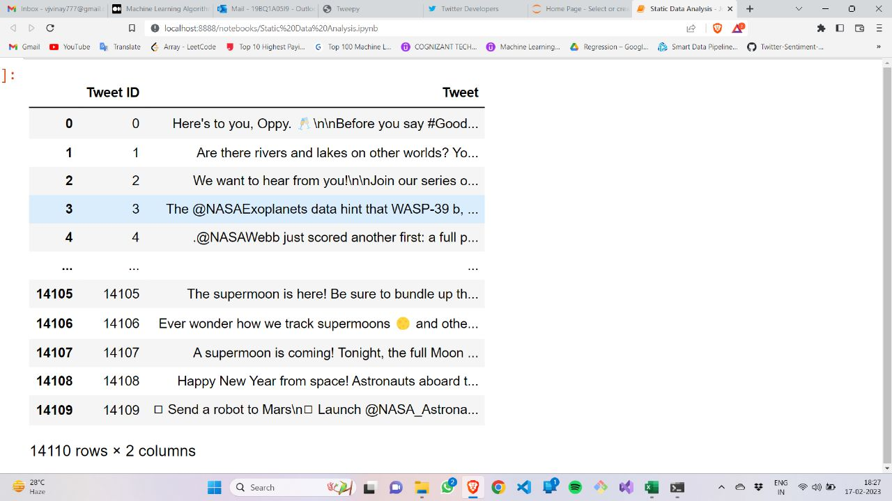
Dataset
Static Data

Slide 6
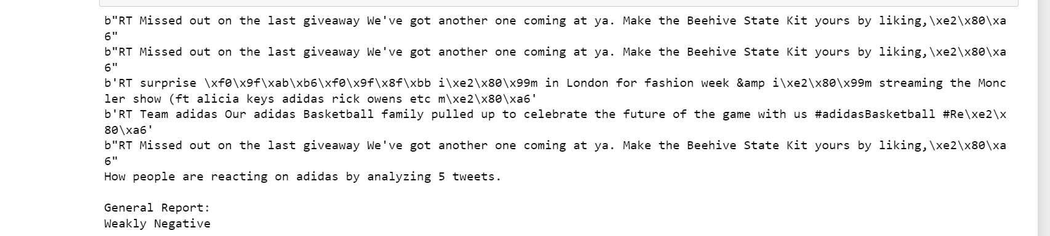
Real Time Data

Slide 7
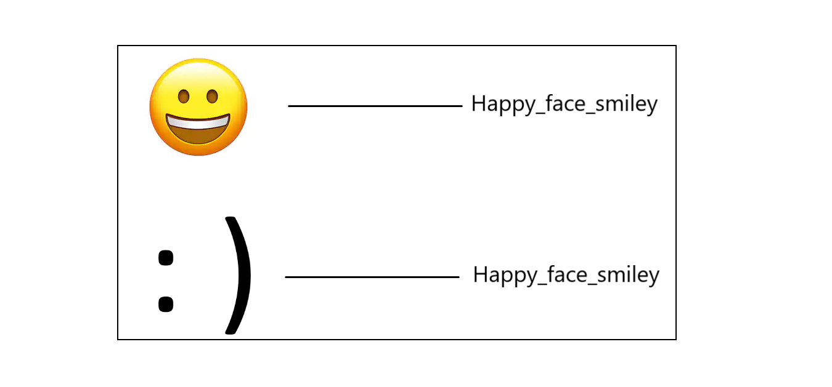
Data Preprocessing
1.Conversion of emoji to text
The python emot library functions can detect emojis and emoticons so that the infiltrated emojis in tweet have converted to text.

Slide 8
2. Conversion to lowercase
It significantly helps with consistency of expected output.
(e.g. ‘Canada’ vs. ‘canada’)
3. Removal of HTML tags and URLs
These tags won’t add any value to the text data.
4. Removal of Punctuations
The words that contain punctuation marks is treated as similar to normal words.
(e.g. ‘hello!’ vs ‘hello’)

Slide 9
5. Removal of stopwords
Words which doesn’t provide much useful information to the model.
(e.g. ‘the’, ‘an’, ‘so’)
6. Stemming
Stemming is used to normalize words into its base form or root form.
(e.g. ‘celebrates’, ‘celebrating’, ‘celebrated’ are originated with a single root word ‘celebrate’)
The main problem in stemming is that sometimes it produces the root word which may not have any meaning.
(e.g. ‘intelligence’, ‘intelligent’ is converted as ‘intelligen’ which has no meaning.)

Slide 10
7. Lemmatization
It is used to group different inflected forms of the word, called Lemma.
The main difference between Stemming and lemmatization is that it produces the root word, which has a meaning.
For example: In lemmatization, the words intelligence, intelligent, and intelligently has a root word intelligent, which has a meaning.

Slide 11
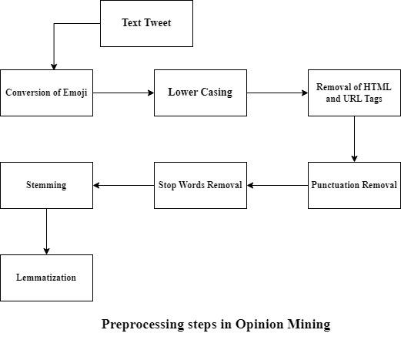

Slide 12
TextBlob
It provides a simple API for diving into common natural language processing (NLP) tasks such as part-of-speech tagging, noun phrase extraction, sentiment analysis, classification, translation, and more.
Sentiment property in TextBlob returns Polarity and Subjectivity with in a range of [-1.0, 1.0] and [0.0, 1.0] respectively.

Slide 13
Adding Class Labels
VADER
It is a rule-based sentiment analyzer in which the terms are generally labeled as per their semantic orientation as either positive or negative.
It is available in the nltk library in python and can be used on unlabelled dataset.

Slide 14
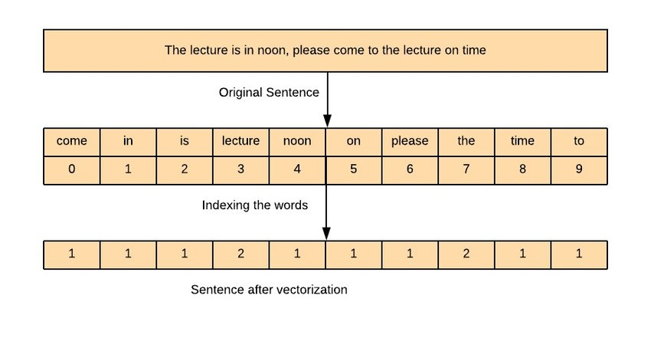
Feature Extraction
CountVectorizer
It is used to transform a given text into a vector on the basis of the frequency (count) of each word that occurs in the entire text.

Slide 15
Support Vector Machine
SVMs are powerful algorithms that can handle non-linear relationships between features and sentiment
SVMs use a kernel function to transform the input data into a higher dimensional space, where a linear boundary can be used to separate the data into positive and negative sentiment
SVMs provide a clear separation between the positive and negative sentiment, which can be easily visualized in two-dimensional space

Slide 16
Pseudo code for SVM
Input: Training dataset (X_train, y_train), Testing dataset (X_test)
Output: Predictions for the testing dataset
Step 1: Preprocess the training and testing dataset
- Convert the text into numerical vectors using techniques like CountVectorizer
- Normalize the data
- Remove stop words and perform stemming or lemmatization if necessary
Step 2: Train the SVM model on the training dataset
- Define the SVM algorithm and its hyperparameters
- Fit the model to the training dataset using the SVM algorithm

Slide 17
Step 3: Test the SVM model on the testing dataset
- Predict the sentiment labels for the testing dataset using the trained SVM model
- Calculate the accuracy, precision, recall, and F1 score of the model on the testing dataset
Step 4: Optimize the SVM model
- Tune the hyperparameters of the SVM model using techniques like cross-validation
- Repeat steps 2 and 3 with the optimized hyperparameters

Slide 18
Decision Tree Classifier
The decision tree algorithm is an paramount tool for sentiment analysis, which is the process of determining the sentiment or emotion expressed in a piece of text.
They are particularly useful for sentiment analysis because they are capture complex relationships between features and sentiment.
Decision tree is used to create a predictive model that can classify new text data into positive or negative sentiment.

Slide 19
Pseudo Code for Decision Tree
Input: Training dataset (X_train, y_train), Testing dataset (X_test)
Output: Predictions for the testing dataset
Step 1: Preprocess the data
- Convert the text into numerical vectors using techniques like CountVectorizer
- Normalize the data
- Remove stop words and perform stemming or lemmatization if necessary
Step 2: Build the Decision Tree
- Define a function to calculate the information gain or other splitting criterion for each feature
- Define the stopping criteria for the tree, such as maximum depth or minimum number instances per node
- Recursively build the tree by selecting the feature with the highest information gain and splitting the dataset
- Assign class labels to the leaf nodes based on the majority class of the instances

Slide 20
Step 3: Test the Decision Tree
- Traverse the Decision Tree for each instance in the testing dataset and predict the class label based on the leaf node reached
- Calculate the accuracy, precision, recall, and F1 score of the model on the testing dataset

Slide 21
Random Forest Classifier
Random forest is less prone to overfitting than a single decision tree
Random forest can be easily parallelized and can handle large datasets with a large number of features
It is particularly effective in situations where there are many features or where the relationship between features and sentiment is complex.

Slide 22
Pseudo Code for Random Forest
Input: Training dataset (X_train, y_train), Testing dataset (X_test)
Output: Predictions for the testing dataset
Step 1: Preprocess the data
- Convert the text into numerical vectors using techniques like CountVectorizer
- Normalize the data
- Remove stop words and perform stemming or lemmatization if necessary
Step 2: Build the Random Forest
- Define the number of decision trees (n_estimators) and the maximum depth of the trees (max_depth)
- Define the stopping criteria for the tree, such as minimum number of instances per leaf node
- For each decision tree:
- Randomly select a subset of the features (max_features) to use for splitting the data
- Sample the training dataset with replacement (bootstrapping) to create a new dataset for training the tree

Slide 23
Step 3: Test the Random Forest
- For each instance in the testing dataset:
- Predict the class label by aggregating the predictions of all decision trees
- Calculate the accuracy, precision, recall, and F1 score of the model on the testing dataset

Slide 24
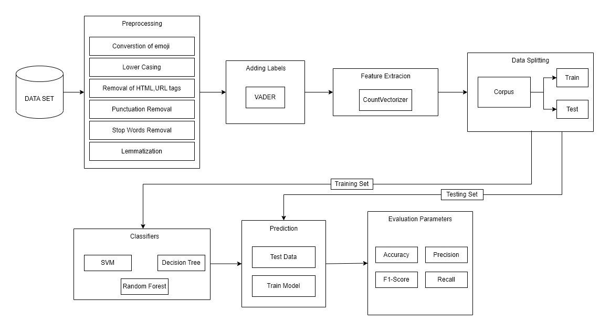
Model Architecture

Slide 25
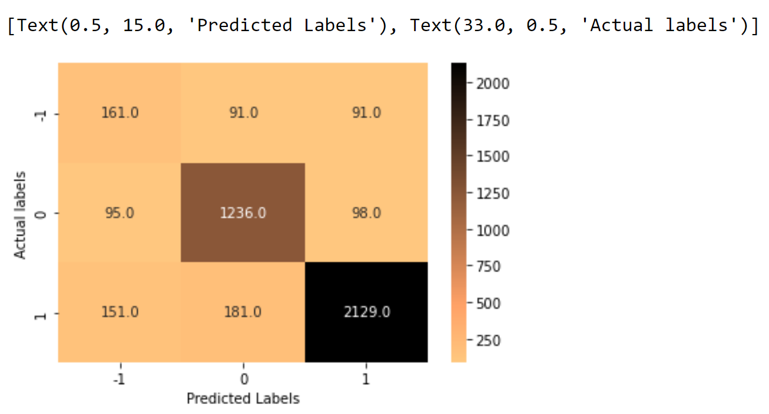
Results
SVM

Slide 26
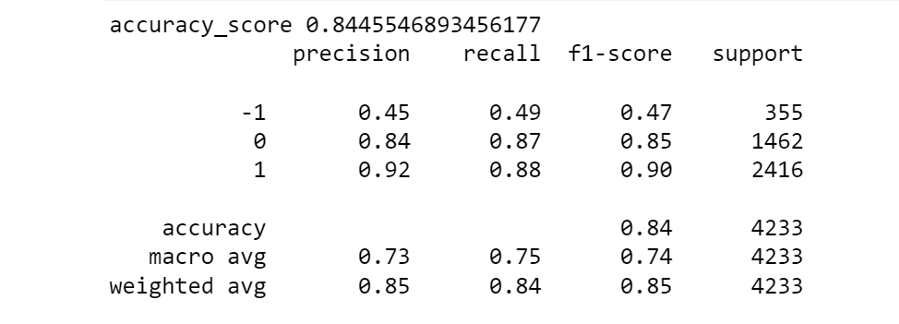
Classification Report

Slide 27
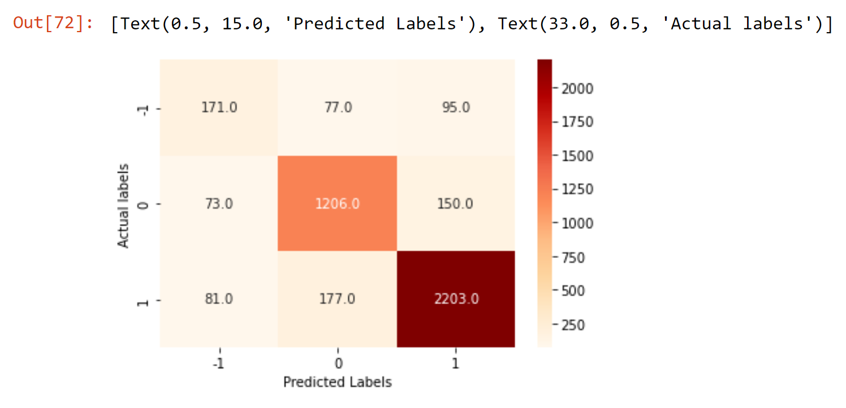
Decision Tree

Slide 28
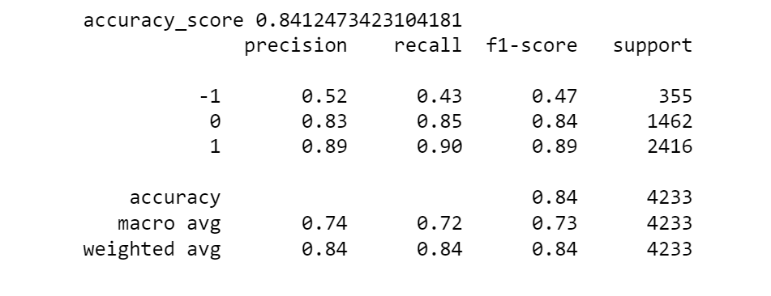
Classification Report

Slide 29
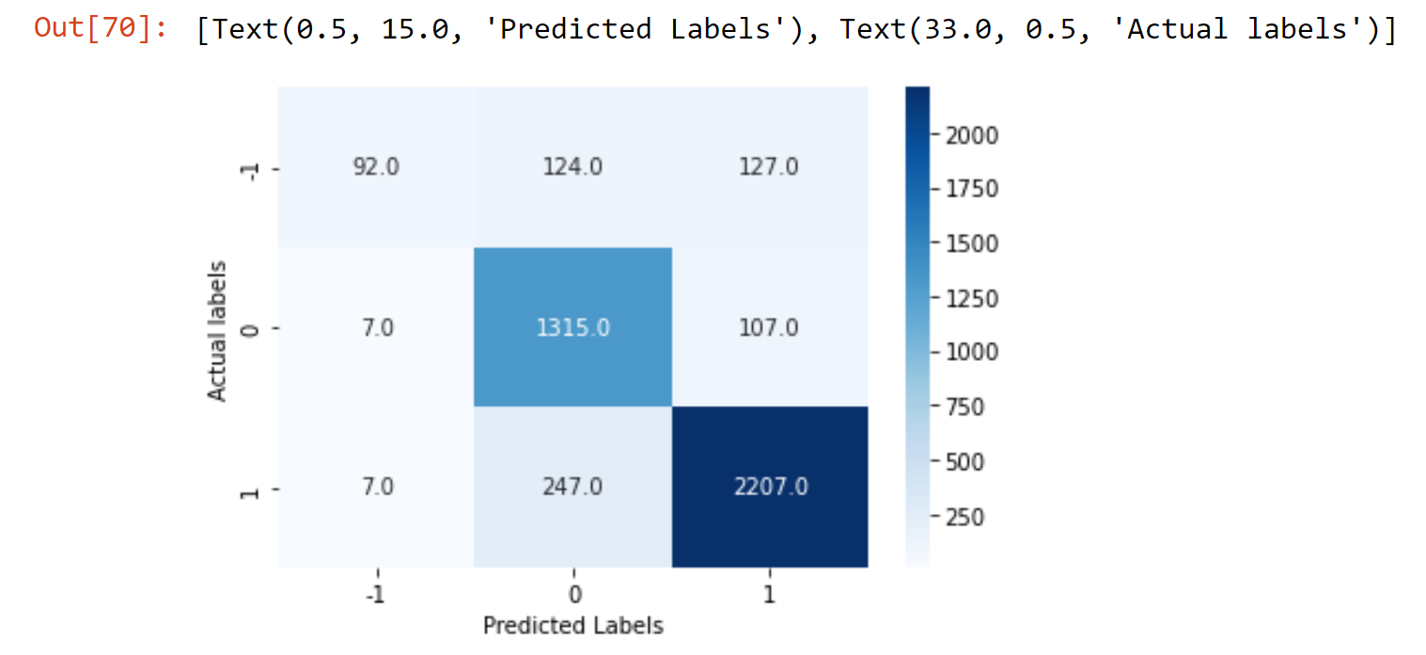
Random Forest

Slide 30
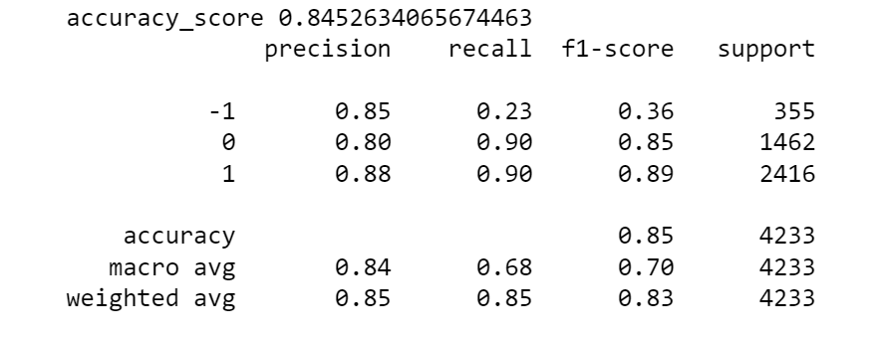
Classification Report

Slide 31
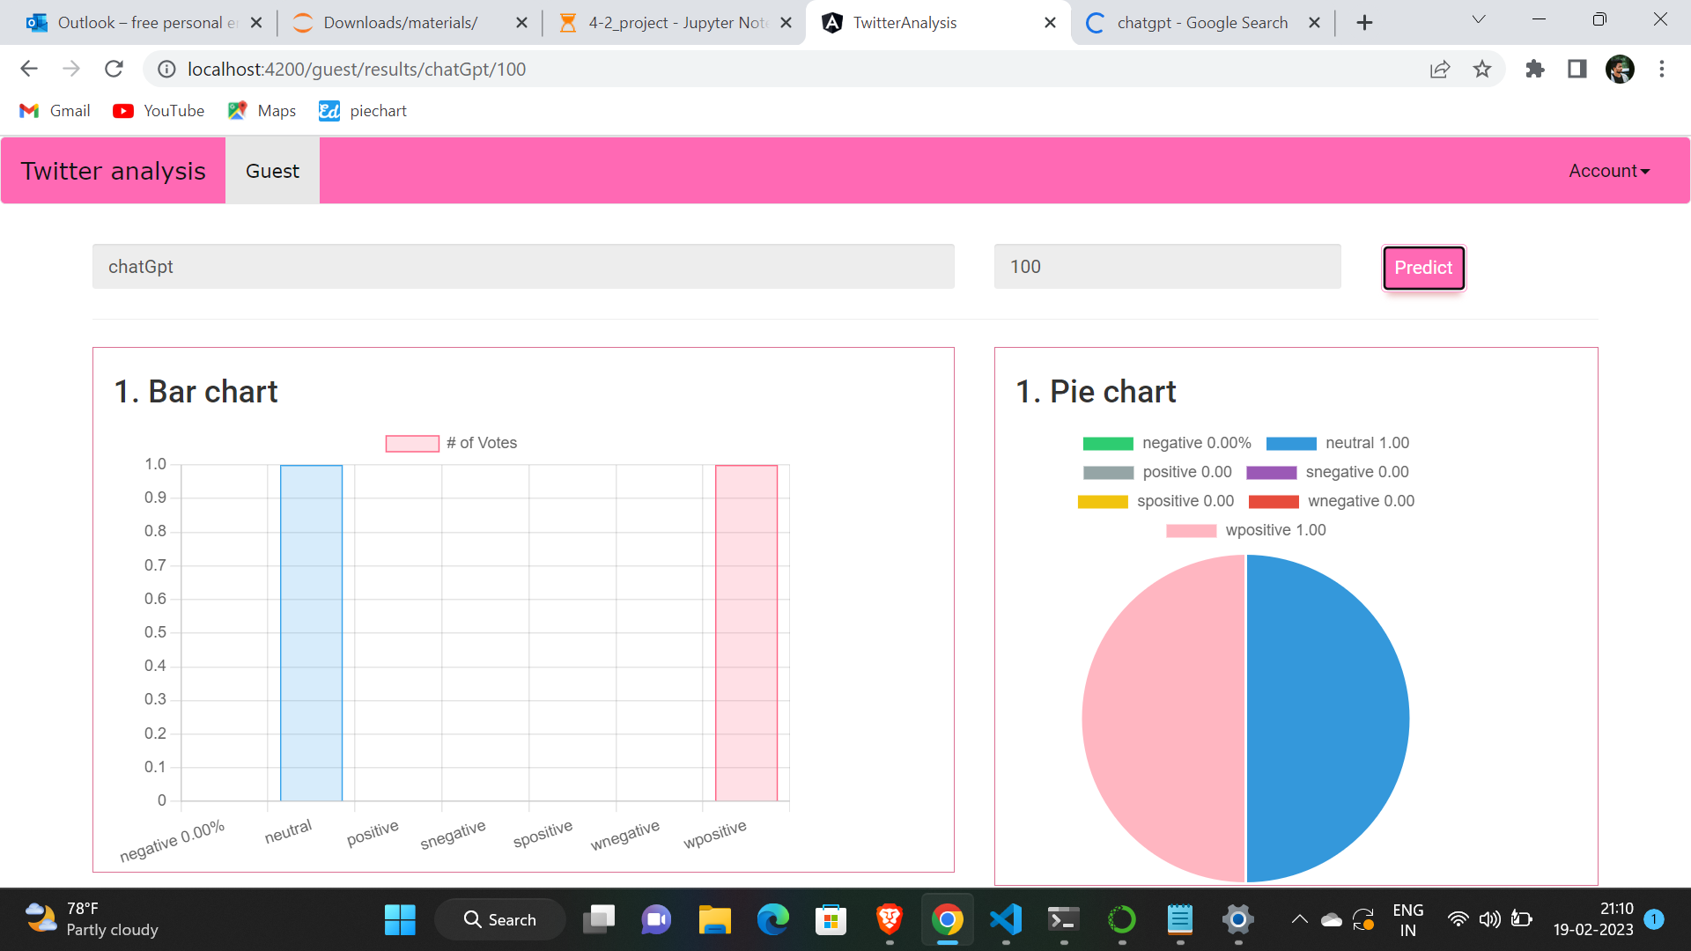
Real Time Data Results

Slide 32
Conclusion
In the context of this work we present an approach that aims to extract Twitter sentiment analysis by converting emojis to text. Experimental results indicate that Random Forest and Decision Tree have an almost similar accuracy which is better than that of the support vector machine(SVM). However, the Random Forest gives the highest accuracy at 85% followed by Decision Tree at 84%, and Support vector machine(SVM) at 83%

Slide 33
THANK YOU

